Slide 1
COMP4901K/Math4824B Machine Learning for Natural Language Processing
Lecture 17: Language Models
Instructor: Yangqiu Song
Slides credits: Hongning Wang

Slide 2
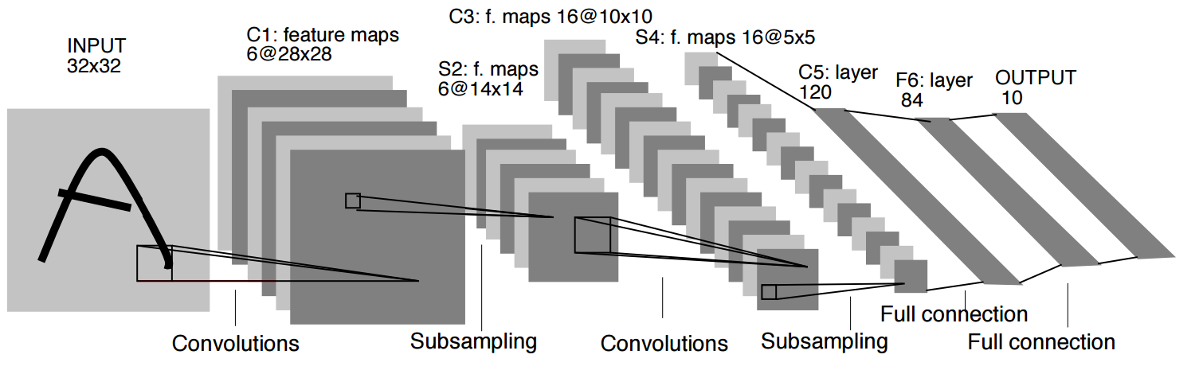
Convolutional Nets
One stage structure:
Whole system:
Convol.
Pooling
Stage 1
Stage 2
Stage 3
Fully Connected Layer
Input Image
Class Label
An example system (LeNet):

Slide 3
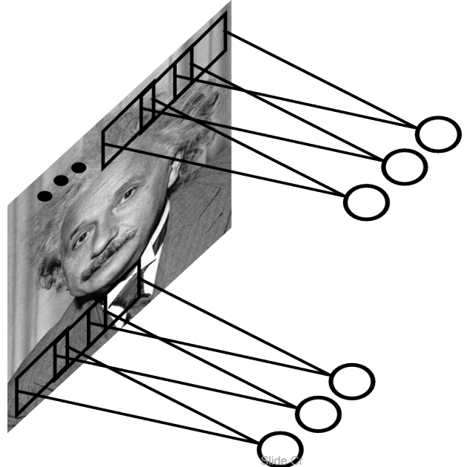
Convolutional Layer
A solution:
Filters to capture different patterns in the input space.
Share parameters across different locations (assuming input is stationary)
Convolutions with learned filters
Filters will be learned during training.
The issue of variable-sized inputs will be
resolved with a pooling layer.
So what is a convolution?

Slide 4
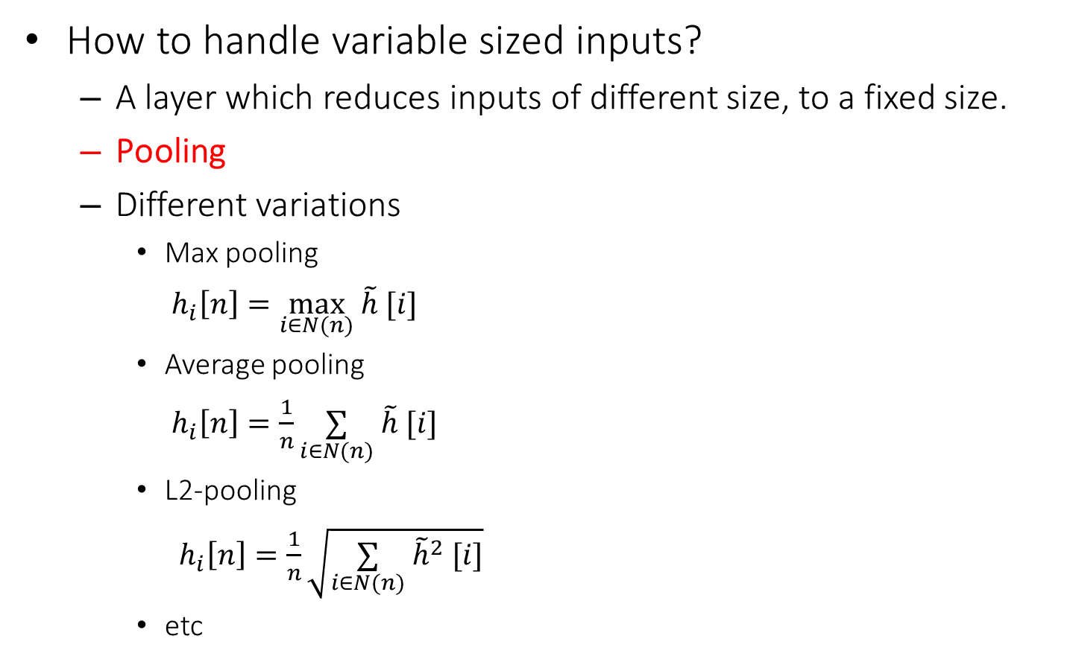
Pooling Layer
How to handle variable sized inputs?
A layer which reduces inputs of different size, to a fixed size.
Pooling
Different variations
Max pooling
$h_{i}\left[n\right]=\max_{i∈N(n)} \tilde{h} [i]$
Average pooling
$h_{i}\left[n\right]=\frac{1}{n}\underset{i∈N(n)}{∑} \tilde{h} [i]$
L2-pooling
$h_{i}\left[n\right]=\frac{1}{n}\sqrt{\underset{i∈N(n)}{∑} {\tilde{h}}^{2} [i]}$
etc

Slide 5
Convolutional Nets
One stage structure:
Whole system:
Convol.
Pooling
Stage 1
Stage 2
Stage 3
Fully Connected Layer
Input Image
Class Label
An example system (LeNet):

Slide 6
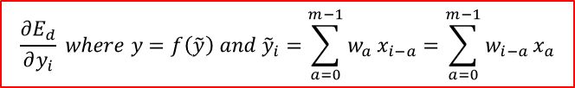







Training a ConvNet
The same procedure from Back-propagation applies here.
Remember in backprop we started from the error terms in the last stage, and passed them back to the previous layers, one by one.
Back-prop for the pooling layer:
Consider, for example, the case of “max” pooling.
This layer only routes the gradient to the input that has the highest value in the forward pass.
Hence, during the forward pass of a pooling layer it is common to keep track of the index of the max activation (sometimes also called the switches) so that gradient routing is efficient during backpropagation.
$$\frac{∂E_{d}}{∂{\tilde{y}}_{i}}$$
$$\frac{∂E_{d}}{∂y_{i}} where y=f\left(\tilde{y}\right) and {\tilde{y}}_{i}=\sum_{a=0}^{m−1}{w_{a}}x_{i−a}=\sum_{a=0}^{m−1}{w_{i−a}}x_{a}$$
$$\frac{∂E_{d}}{∂x_{a}}$$
$$δ_{last−layer}=\frac{∂E_{d}}{∂y_{last−layer}}$$
$$x_{i}$$
Convol.
$$y_{i}$$
Pooling
$$δ_{first−layer}=\frac{∂E_{d}}{∂y_{first−layer}}$$
$$E_{d}$$
Input Image
Stage 1
Stage 2
Stage 3
Fully Connected Layer
Class Label

Slide 7
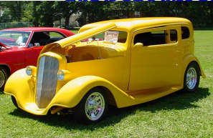
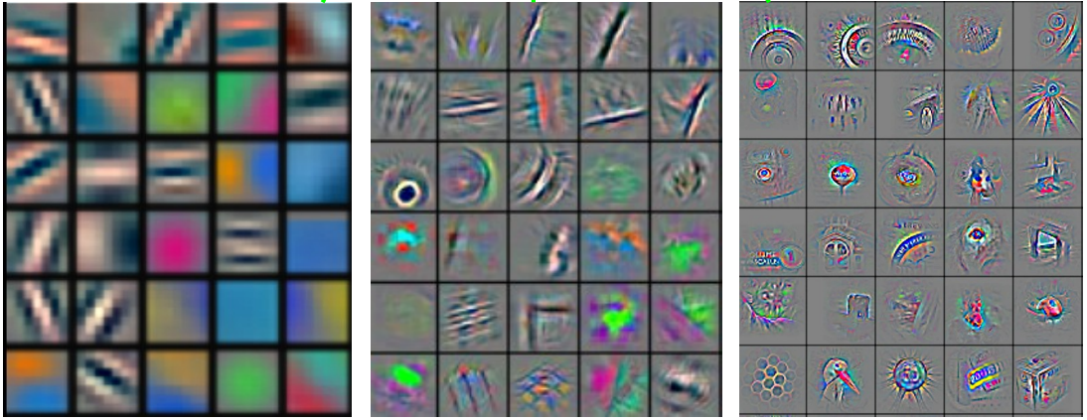
Convolutional Nets
In higher layers, you can visualize some parts of the object.
(high level features)
Stage 1
Stage 2
Stage 3
Fully Connected Layer
Input Image
Class Label
Feature visualization of convolutional net trained on ImageNet from [Zeiler & Fergus 2013]
http://cs231n.github.io/understanding-cnn/

Slide 8
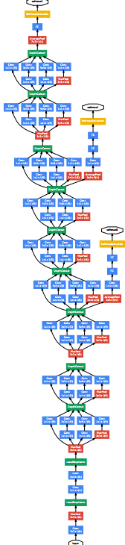
ConvNet roots
Fukushima, 1980s designed network with same basic structure but did not train by backpropagation.
The first successful applications of Convolutional Networks by Yann LeCun in 1990's (LeNet)
Was used to read zip codes, digits, etc.
Many variants nowadays, but the core idea is the same
Example: a system developed in Google (GoogLeNet)
Compute different filters
Compose one big vector from all of them
Layer this iterative
Practically, being deep is more efficient than being wide.
See more: http://arxiv.org/pdf/1409.4842v1.pdf

Slide 9
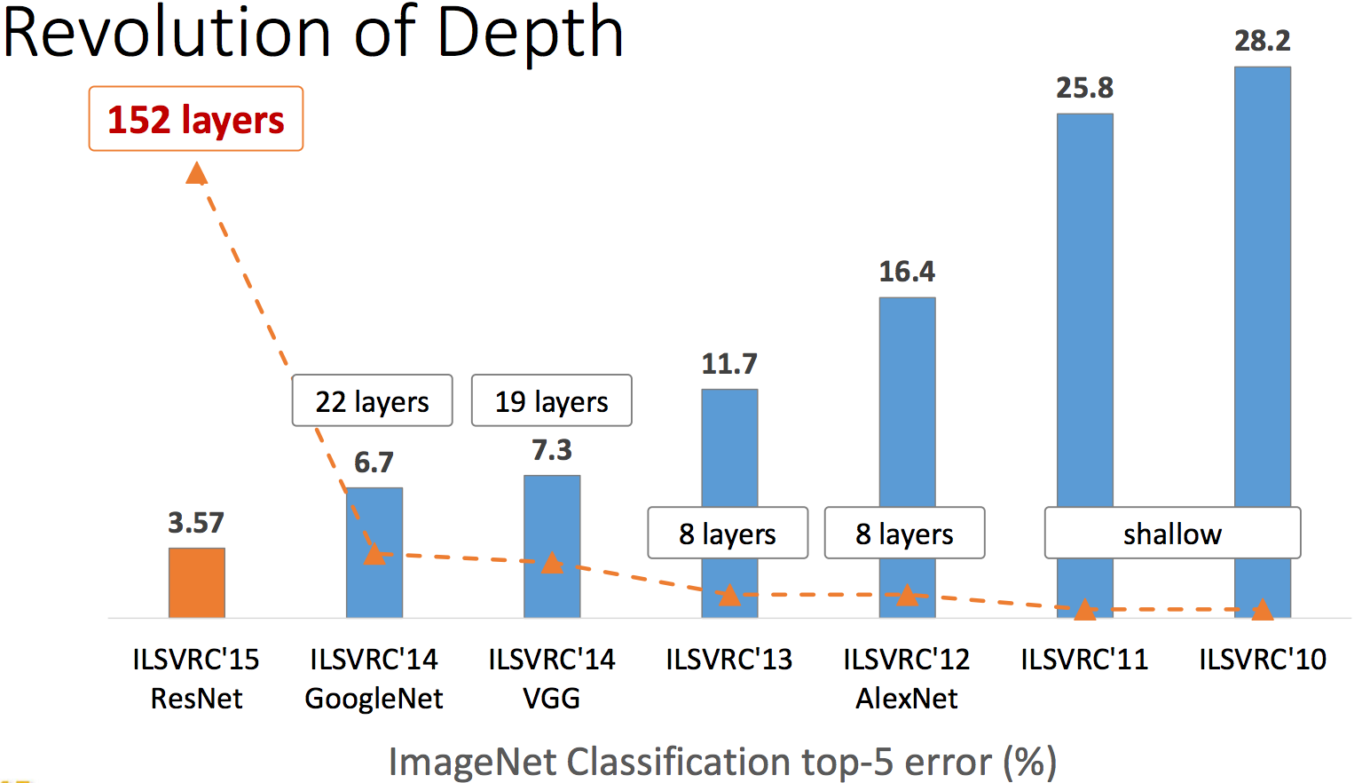
Depth matters
Slide from [Kaiming He 2015]

Slide 10
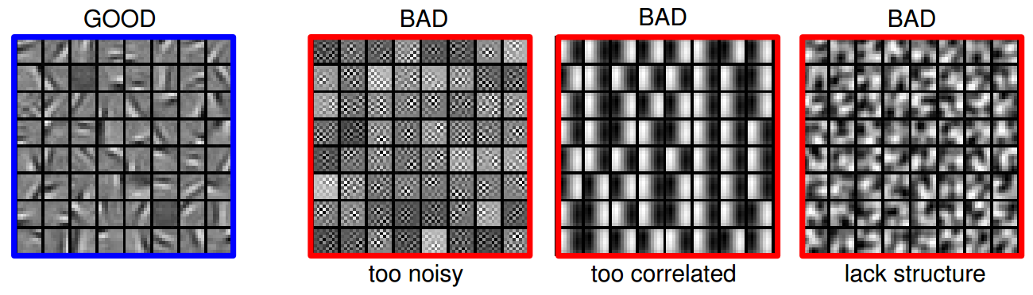
Practical Tips
Before large scale experiments, test on a small subset of the data and check the error should go to zero.
Overfitting on small training
Visualize features (feature maps need to be uncorrelated) and have high variance
Bad training: many hidden units ignore the input and/or exhibit strong correlations.
Figure Credit: Marc'Aurelio Ranzato

Slide 11
Debugging
Training diverges:
Learning rate may be too large → decrease learning rate
BackProp is buggy → numerical gradient checking
Loss is minimized but accuracy is low
Check loss function: Is it appropriate for the task you want to solve? Does it have degenerate solutions?
NN is underperforming / under-fitting
Compute number of parameters → if too small, make network larger
NN is too slow
Compute number of parameters → Use distributed framework, use GPU, make network smaller
Many of these points apply to many machine learning models, no just neural networks.

Slide 12
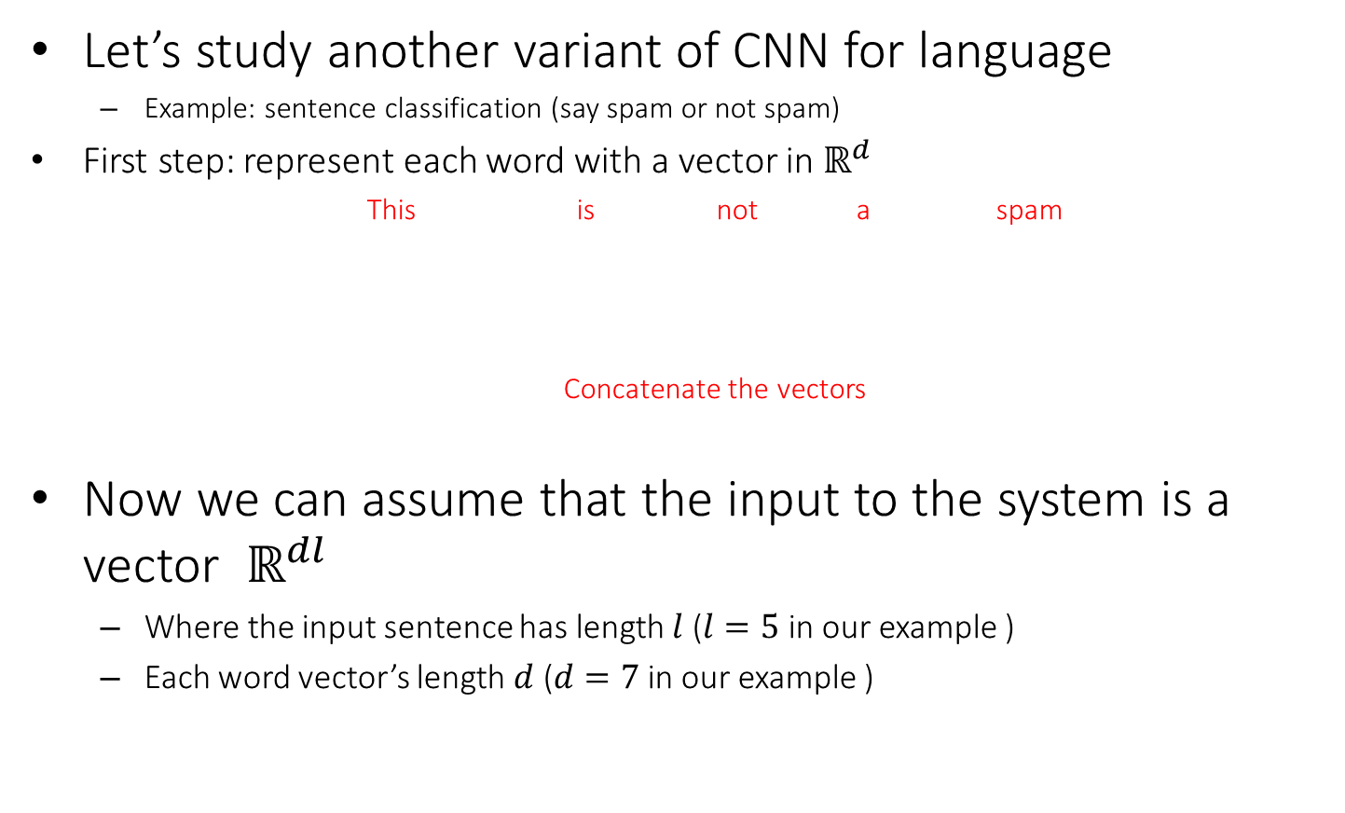
CNN for vector inputs
Let’s study another variant of CNN for language
Example: sentence classification (say spam or not spam)
First step: represent each word with a vector in $ℝ^{d}$
This is not a spam
Concatenate the vectors
Now we can assume that the input to the system is a vector $ℝ^{dl}$
Where the input sentence has length $l$ ($l=5$ in our example )
Each word vector’s length $d$ ($d=7$ in our example )
O O O O O O O
O O O O O O O
O O O O O O O
O O O O O O O
O O O O O O O
O O O O O O O O O O O O O O O O O O O O O O O O O O O O O O O O O O O

Slide 13






Convolutional Layer on vectors
Think about a single convolutional layer
A bunch of vector filters
Each defined in $ℝ^{dh}$
Where $h$ is the number of the words the filter covers
Size of the word vector $d$
Find its (modified) convolution with the input vector
Result of the convolution with the filter
Extract the semantic meaning of two consecutive words. After doing so, you actually obtain all bi-gram features of the text.
Convolution with a filter that spans 2 words, is operating on all of the bi-grams (vectors of two consecutive word, concatenated): “this is”, “is not”, “not a”, “a spam”.
Regardless of whether it is grammatical (not appealing linguistically)
O O O O O O O O O O O O O O
O O O O O O O O O O O O O O
O O O O O O O O O O O O O O
O O O O O O O O O O O O O O
O O O O O O O O O O O O O O
O O O O O O O O O O O O O O O O O O O O O O O O O O O O O O O O O O O
O O O O O O O O O O O O O O O O O O O O O O O O O O O O O O O O O O O
O O O O O O O O O O O O O O O O O O O O O O O O O O O O O O O O O O O
O O O O O O O O O O O O O O O O O O O O O O O O O O O O O O O O O O O
O O O O O O O O O O O O O O O O O O O O O O O O O O O O O O O O O O O
$$c_{1}=f(w.x_{1:h})$$
$$c_{2}=f(w.x_{h+1:2h})$$
$$c_{3}=f(w.x_{2h+1:3h})$$
$$c_{4}=f(w.x_{3h+1:4h})$$
$$c=[c_{1}, …., c_{n−h+1}]$$
O O O O

Slide 14
Convolutional Layer on vectors
This is not a spam
Get word vectors for each words
O O O O O O O
O O O O O O O
O O O O O O O
O O O O O O O
O O O O O O O
Concatenate vectors
O O O O O O O O O O O O O O O O O O O O O O O O O O O O O O O O O O O
*
Perform convolution with each filter
O O O O O O O
O O O O O O O O O O O O O O
Filter bank
O O O O O O O O O O O O O O
O O O O O O O O O O O O O O O O O O O O O
O O O O O O O O O O O O O O O O O O O O O
How are we going to handle the variable sized response vectors?
Pooling!
O O O O O
O O O O
Set of response vectors
#of filters
O O O O
O O O
O O O
#words - #length of filter + 1

Slide 15
Convolutional Layer on vectors
This is not a spam
Get word vectors for each words
Now we can pass the fixed-sized vector to a logistic unit (softmax), or give it to multi-layer network (last session)
O O O O O O O
O O O O O O O
O O O O O O O
O O O O O O O
O O O O O O O
Concatenate vectors
O O O O O O O O O O O O O O O O O O O O O O O O O O O O O O O O O O O
*
Perform convolution with each filter
O O O O O O O
O O O O O O O O O O O O O O
Filter bank
O O O O O O O O O O O O O O
O O O O O O O O O O O O O O O O O O O O O
O O O O O O O O O O O O O O O O O O O O O
Some choices for pooling:
k-max, mean, etc
Pooling on filter responses
O O O O O
O O O
O O O O
O O O
#of filters
O O O O
O O O
O O O
O O O
O O O
O O O
#words - #length of filter + 1

Slide 16
Today’s lecture
How to represent a document?
Make it computable
How to infer the relationship among documents or identify the structure within a document?
Knowledge discovery

Slide 17
What is a statistical LM?
A model specifying probability distribution over word sequences
p(“Today is Wednesday”) ≈ 0.001
p(“Today Wednesday is”) ≈ 0.0000000000001
p(“The eigenvalue is positive”) ≈ 0.00001
It can be regarded as a probabilistic mechanism for “generating” text, thus also called a “generative” model

Slide 18
Why is a LM useful?
Provide a principled way to quantify the uncertainties associated with natural language
Allow us to answer questions like:
Given that we see “John” and “feels”, how likely will we see “happy” as opposed to “habit” as the next word?
(speech recognition)
Given that we observe “baseball” three times and “game” once in a news article, how likely is it about “sports” v.s. “politics”?
(text categorization)
Given that a user is interested in sports news, how likely would the user use “baseball” in a query?
(information retrieval)

Slide 19

Measure the fluency of documents
How likely this document is generated by a given language model
If $p_{text−mining}\left(d\right)>p_{health}(d)$, $d$ belongs to text mining related documents
If $p_{user_{a}}\left(d_{1}\right)>p_{user_{a}}(d_{2})$, recommend $d_{1}$ to $user_{a}$

Slide 20
Source-Channel framework ^{[Shannon 48]}
Source
Transmitter
(encoder)
Noisy
Channel
Receiver
(decoder)
Destination
X
Y
X’
P(X)
P(X|Y)=?
P(Y|X)
(Bayes Rule)
When X is text, p(X) is a language model
Many Examples:
Speech recognition: X=Word sequence Y=Speech signal
Machine translation: X=English sentence Y=Chinese sentence
OCR Error Correction: X=Correct word Y= Erroneous word
Information Retrieval: X=Document Y=Query
Summarization: X=Summary Y=Document

Slide 21
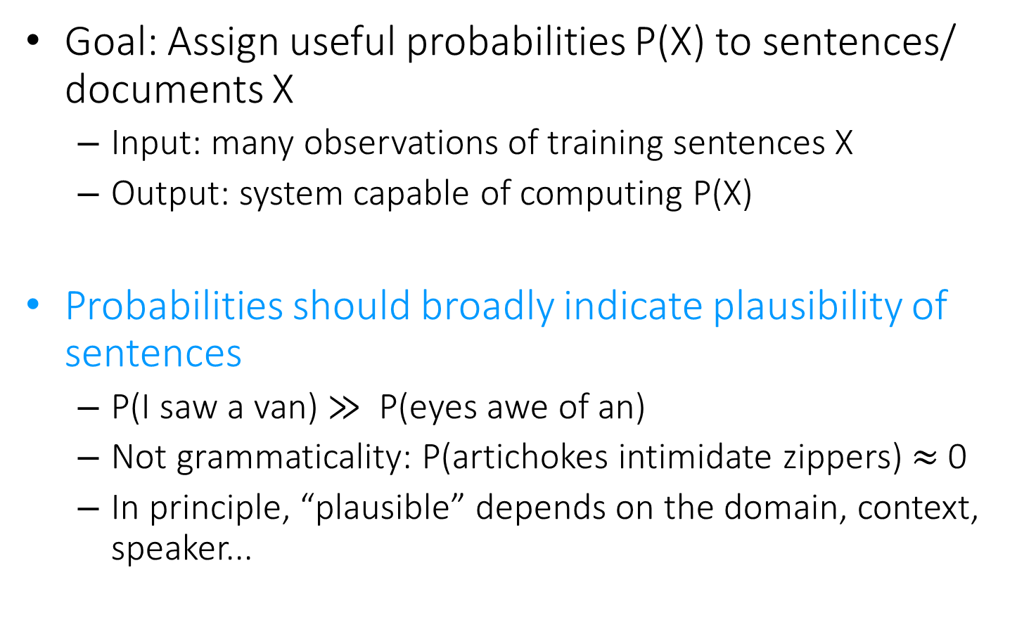
Language Model for Text
Goal: Assign useful probabilities P(X) to sentences/ documents X
Input: many observations of training sentences X
Output: system capable of computing P(X)
Probabilities should broadly indicate plausibility of sentences
P(I saw a van) $≫$ P(eyes awe of an)
Not grammaticality: P(artichokes intimidate zippers) $≈$ 0
In principle, “plausible” depends on the domain, context, speaker...

Slide 22



Language model for text
We need independence assumptions!
Probability distribution over word sequences
$p\left(w1 w2 … wn\right)=p\left(w1\right)p\left(w_{2} | w_{1}\right)p\left(w_{3} | w_{1},w_{2}\right)…p\left(w_{n} | w_{1},w_{2},…,w_{n−1}\right)$
Complexity - $O(V^{n^{∗}})$
$n^{∗}$ - maximum document length
sentence
Chain rule: from conditional probability to joint probability
475,000 main headwords in Webster's Third New International Dictionary
Average English sentence length is 14.3 words
A rough estimate: $O({475000}^{14})$
How large is this?
$$≈3.38e^{66}TB$$

Slide 23

Unigram language model
Generate a piece of text by generating each word independently
$p(w1 w2 … wn)=p(w1)p(w2)…p(wn)$
Looks familiar?
Essentially a multinomial distribution over the vocabulary
The simplest and most popular choice!

Slide 24
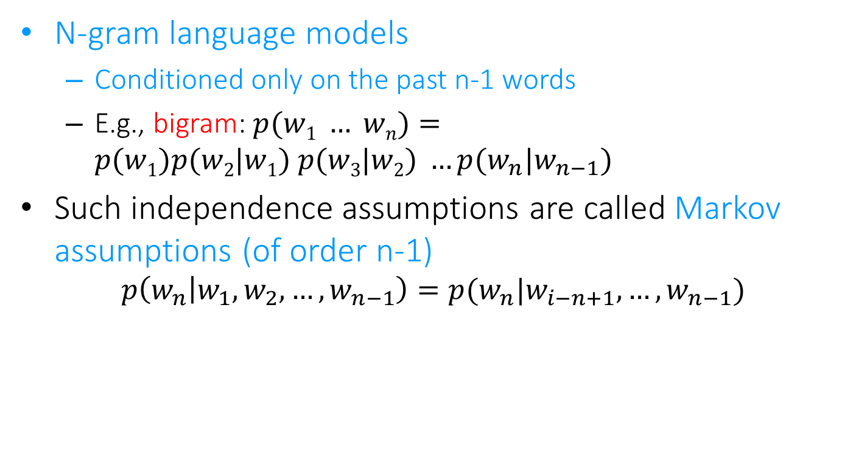
More sophisticated LMs
N-gram language models
Conditioned only on the past n-1 words
E.g., bigram: $p(w1 … wn)=p(w1)p(w2|w1) p(w3|w2) …p(w_{n}|w_{n−1})$
Such independence assumptions are called Markov assumptions (of order n-1)
$$p\left(w_{n} | w_{1},w_{2},…,w_{n−1}\right)=p(w_{n}|w_{i−n+1},…,w_{n−1})$$

Slide 25
Why just unigram models?
Difficulty in moving toward more complex models
They involve more parameters, so need more data to estimate
They increase the computational complexity significantly, both in time and space
Capturing word order or structure may not add so much value for “topical inference”
But, using more sophisticated models can still be expected to improve performance ...

Slide 26
Recap: what is a statistical LM?
A model specifying probability distribution over word sequences
p(“Today is Wednesday”) ≈ 0.001
p(“Today Wednesday is”) ≈ 0.0000000000001
p(“The eigenvalue is positive”) ≈ 0.00001
It can be regarded as a probabilistic mechanism for “generating” text, thus also called a “generative” model

Slide 27
Recap: Source-Channel framework ^{[Shannon 48]}
Source
Transmitter
(encoder)
Noisy
Channel
Receiver
(decoder)
Destination
X
Y
X’
P(X)
P(X|Y)=?
P(Y|X)
(Bayes Rule)
When X is text, p(X) is a language model
Many Examples:
Speech recognition: X=Word sequence Y=Speech signal
Machine translation: X=English sentence Y=Chinese sentence
OCR Error Correction: X=Correct word Y= Erroneous word
Information Retrieval: X=Document Y=Query
Summarization: X=Summary Y=Document

Slide 28
Generative view of text documents
(Unigram) Language Model θ
p(w| θ)
Sampling
Document
…
text 0.2
mining 0.1
assocation 0.01
clustering 0.02
…
food 0.00001
…
Topic 1:
Text mining
Text mining
document
…
text 0.01
food 0.25
nutrition 0.1
healthy 0.05
diet 0.02
…
Food nutrition
document
Topic 2:
Health

Slide 29
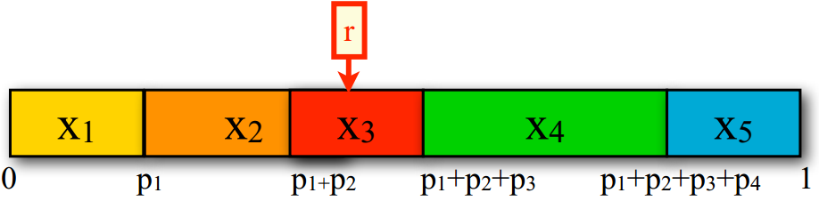
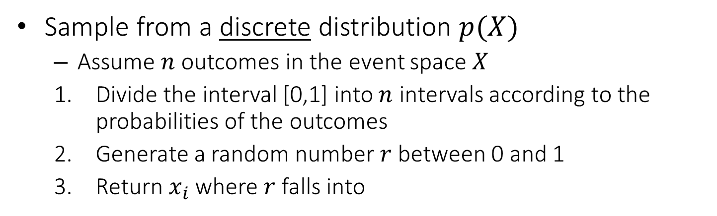
How to generate text from an N-gram language model?
Sample from a discrete distribution $p(X)$
Assume $n$ outcomes in the event space $X$
Divide the interval [0,1] into $n$ intervals according to the probabilities of the outcomes
Generate a random number $r$ between 0 and 1
Return $x_{i}$ where $r$ falls into

Slide 30
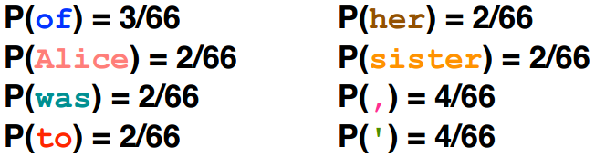
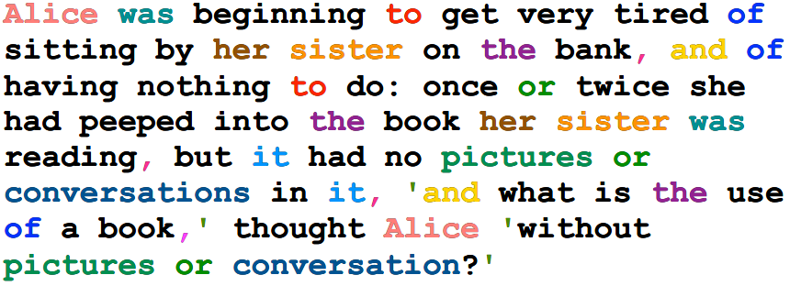
Generating text from language models
Under a unigram language model:

Slide 31
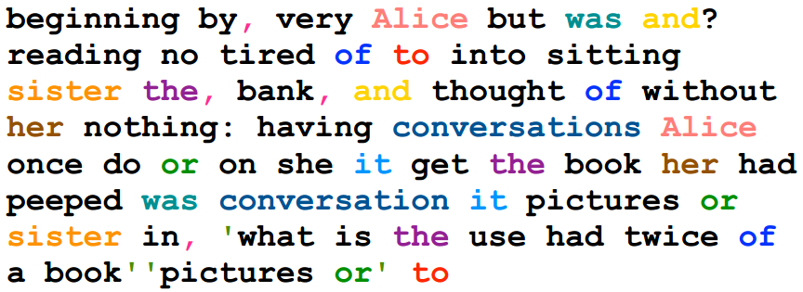
Generating text from language models
Under a unigram language model:
The same likelihood!

Slide 32
N-gram language models will help
Unigram
Months the my and issue of year foreign new exchange’s september were recession exchange new endorsed a q acquire to six executives.
Bigram
Last December through the way to preserve the Hudson corporation N.B.E.C. Taylor would seem to complete the major central planners one point five percent of U.S.E. has already told M.X. corporation of living on information such as more frequently fishing to keep her.
Trigram
They also point to ninety nine point six billon dollars from two hundred four oh six three percent of the rates of interest stores as Mexico and Brazil on market conditions.
Generated from language models of New York Times

Slide 33
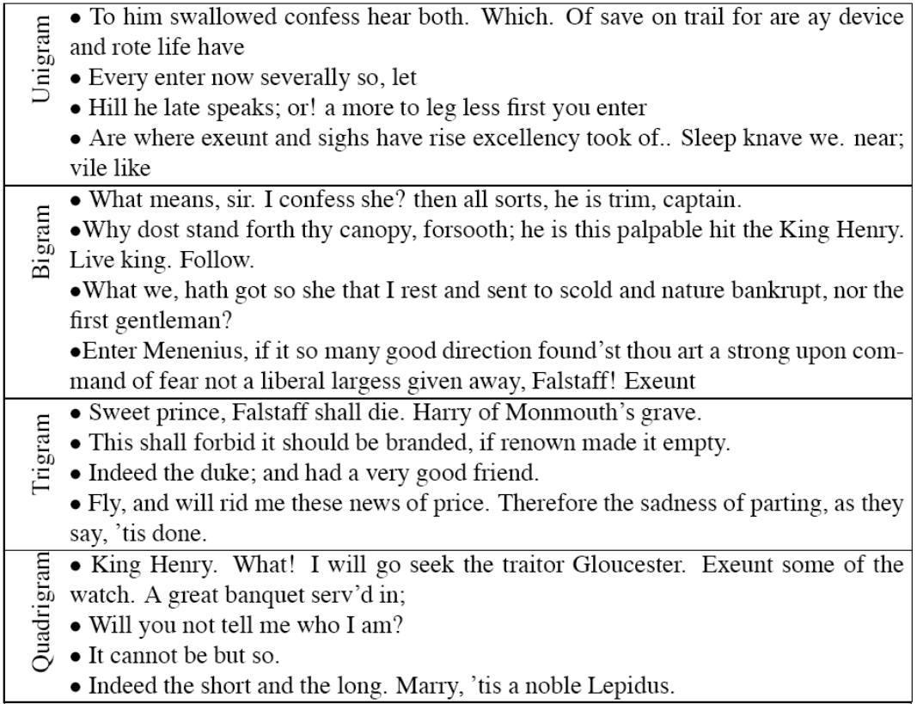

Turing test: generating Shakespeare
A
B
SCIgen - An Automatic CS Paper Generator
C
D

Slide 34
Estimation of language models
Unigram Language Model θ
p(w| θ)=?
Estimation
Document
…
text ?
mining ?
assocation ?
database ?
…
query ?
…
text 10
mining 5
association 3
database 3
algorithm 2
…
query 1
efficient 1
A “text mining” paper
(total #words=100)

Slide 35
Estimation of language models
Maximum likelihood estimation
Unigram Language Model θ
p(w| θ)=?
Estimation
Document
…
text ?
mining ?
assocation ?
database ?
…
query ?
…
text 10
mining 5
association 3
database 3
algorithm 2
…
query 1
efficient 1
10/100
5/100
3/100
3/100
1/100
A “text mining” paper
(total #words=100)

Slide 36
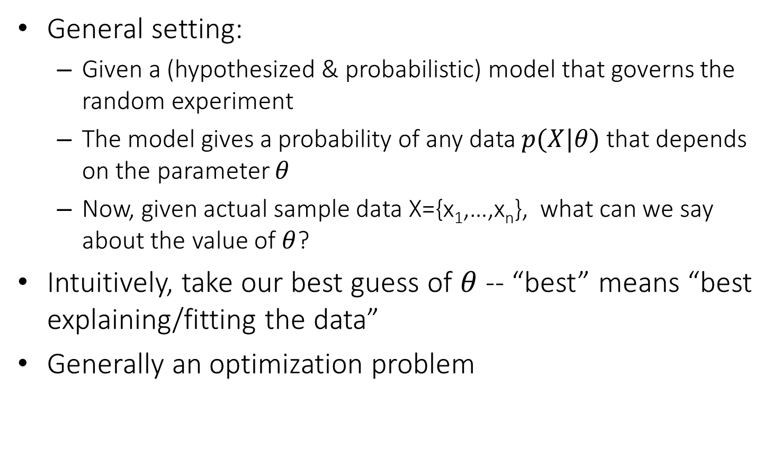
Parameter estimation
General setting:
Given a (hypothesized & probabilistic) model that governs the random experiment
The model gives a probability of any data $p(X|θ)$ that depends on the parameter $θ$
Now, given actual sample data X={x₁,…,x_{n}}, what can we say about the value of $θ$?
Intuitively, take our best guess of $θ$ -- “best” means “best explaining/fitting the data”
Generally an optimization problem

Slide 37

Maximum likelihood vs. Bayesian
Maximum likelihood estimation
“Best” means “data likelihood reaches maximum”
Issue: small sample size
Maximum a Posterior estimation (MAP) estimation
“Best” means being consistent with our “prior” knowledge and explaining data well
Issue: how to define prior?
$$\hat{θ}={argmax}_{θ}P(X|θ)$$
ML: Frequentist’s point of view
$$\hat{θ}={argmax_{θ}P\left(θ | X\right)=argmax}_{θ}P\left(X | θ\right)P(θ)$$
MAP: Bayesian’s point of view

Slide 38
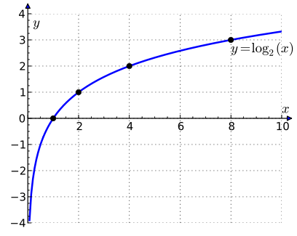
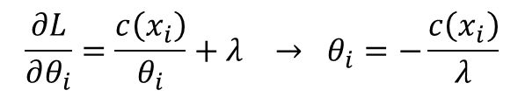
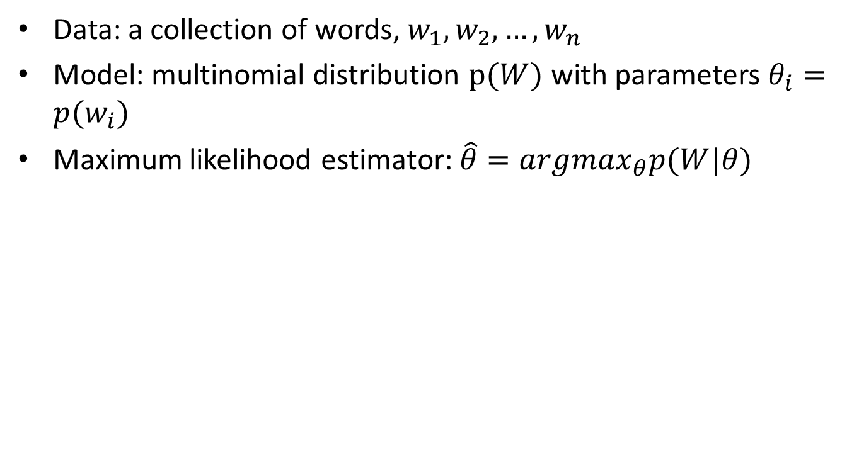
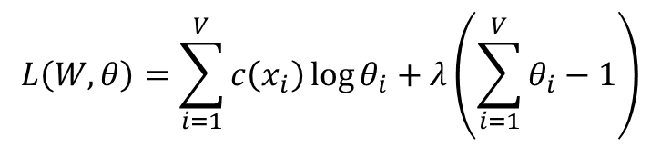
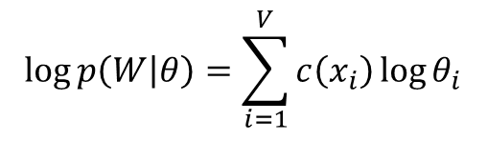

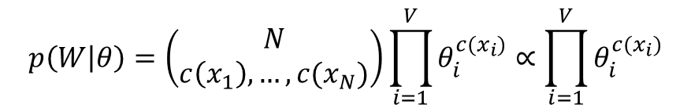

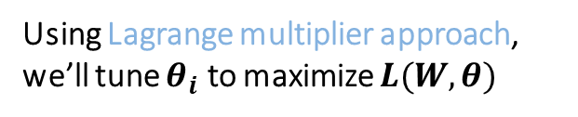
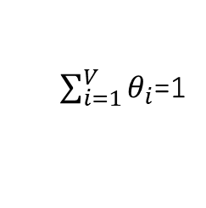
Maximum likelihood estimation
Data: a collection of words, $w_{1},w_{2},…,w_{n}$
Model: multinomial distribution $p(W)$ with parameters $θ_{i}=p(w_{i})$
Maximum likelihood estimator: $\hat{θ}=argmax_{θ}p(W|θ)$
$$p\left(W | θ\right)=\left(\begin{matrix}N \\ c\left(x_{1}\right),…,c(x_{N})\end{matrix}\right)\prod_{i=1}^{V}{θ_{i}^{c(x_{i})}}∝\prod_{i=1}^{V}{θ_{i}^{c(x_{i})}}$$
$$\log{p\left(W | θ\right)}=\sum_{i=1}^{V}{c\left(x_{i}\right)\log{θ_{i}}}$$
$$L\left(W,θ\right)=\sum_{i=1}^{V}{c\left(x_{i}\right)\log{θ_{i}}}+λ\left(\sum_{i=1}^{V}{θ_{i}}−1\right)$$
Using Lagrange multiplier approach, we’ll tune $θ_{i}$ to maximize $L(W,θ)$
$$\frac{∂L}{∂θ_{i}}=\frac{c\left(x_{i}\right)}{θ_{i}}+λ → θ_{i}=−\frac{c\left(x_{i}\right)}{λ}$$
Set partial derivatives to zero
$$λ=−\sum_{i=1}^{V}{c\left(x_{i}\right)}$$
Since
$\sum_{i=1}^{V}{θ_{i}}$=1
we have
Requirement from probability
$$θ_{i}=\frac{c\left(x_{i}\right)}{\sum_{i=1}^{V}{c\left(x_{i}\right)}}$$
ML estimate

Slide 39


Maximum likelihood estimation
For N-gram language models
$p\left(w_{i} | w_{i−1},…,w_{i−n+1}\right)=\frac{c(w_{i},w_{i−1},…,w_{i−n+1})}{c(w_{i−1},…,w_{i−n+1})}$
$c\left(∅\right)=N$
For the ease of notations, we denote $w_{i}$ as $w_{i}=x_{i}$ as the unique word type in vocabular
Length of document or total number of words in a corpus

Slide 40
Problem with MLE
Unseen events
We estimated a model on 440K word tokens, but:
Only 30,000 unique words occurred
Only 0.04% of all possible bigrams occurred
This means any word/N-gram that does not occur in the training data has zero probability!
No future documents can contain those unseen words/N-grams

Slide 41
Smoothing
If we want to assign non-zero probabilities to unseen words
Unseen words = new words, new N-grams
Discount the probabilities of observed words
General procedure
Reserve some probability mass of words seen in a document/corpus
Re-allocate it to unseen words

Slide 42
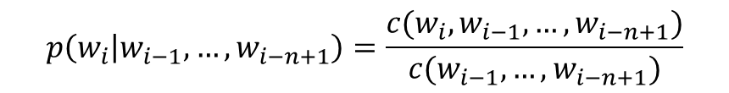

Illustration of N-gram language model smoothing
Seen word 概率减小，被匀到了unseen word上面
$$p\left(w_{i} | w_{i−1},…,w_{i−n+1}\right)$$
Max. Likelihood Estimate
$$p\left(w_{i} | w_{i−1},…,w_{i−n+1}\right)=\frac{c(w_{i},w_{i−1},…,w_{i−n+1})}{c(w_{i−1},…,w_{i−n+1})}$$
Smoothed LM
w
Discount from the seen words
Assigning nonzero probabilities to the unseen words

Slide 43

Smoothing methods
Additive smoothing
Add a constant δ to the counts of each word
Unigram language model as an example
Problems?
Hint: all words are equally important?
Counts of w in d
“Add one”, Laplace smoothing
$$p\left(w | d\right)=\frac{c\left(w,d\right)+δ}{\left|d\right|+δ|V|}$$
Vocabulary size
Length of d (total counts)

Slide 44
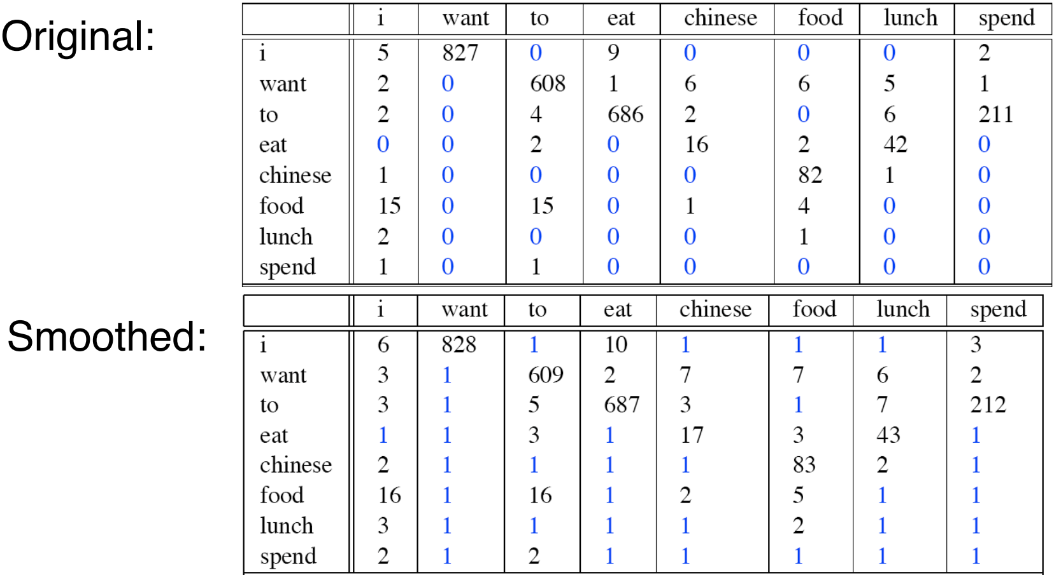
Add one smoothing for bigrams

Slide 45
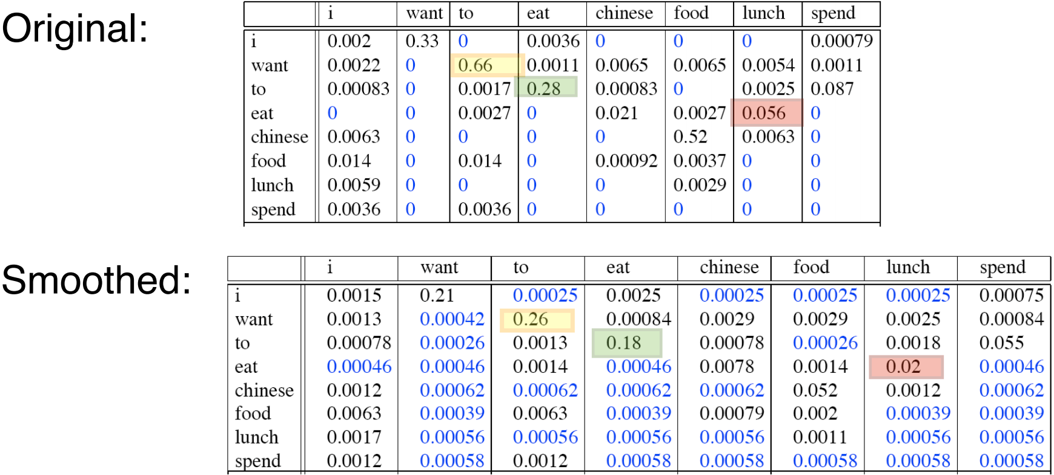
After smoothing
Giving too much to the unseen events

Slide 46
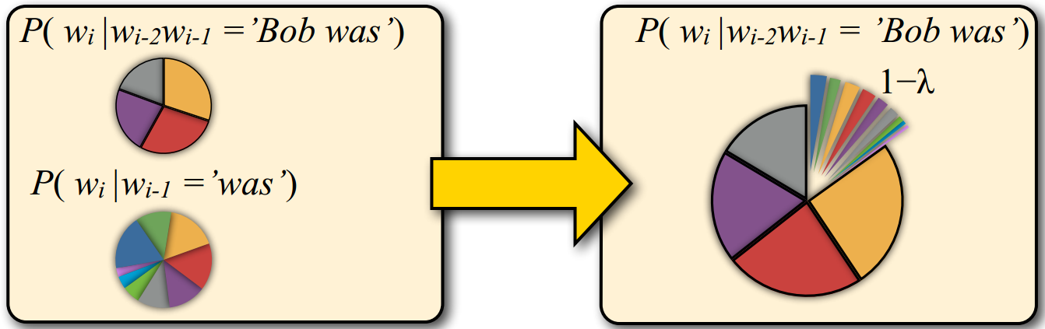
Smoothing methods
Linear interpolation
Use (N –1)-gram probabilities to smooth N-gram probabilities
We never see the trigram “Bob was reading”, but we do see the bigram “was reading”

Slide 47




Smoothing methods
Linear interpolation
Use (N –1)-gram probabilities to smooth N-gram probabilities
Further generalize it
ML N-gram
$$\overline{p}\left(w_{i} | w_{i−1},…,w_{i−n+1}\right)=λp_{ML}\left(w_{i} | w_{i−1},…,w_{i−n+1}\right)$$
$$+(1−λ)\overline{p}\left(w_{i} | w_{i−1},…,w_{i−n+2}\right)$$
Smoothed N-gram
Smoothed (N-1)-gram
$$\overline{p}\left(w_{i} | w_{i−1},…,w_{i−n+1}\right)=λ_{1}p_{ML}\left(w_{i} | w_{i−1},…,w_{i−n+1}\right)$$
$$+λ_{2}\overline{p}\left(w_{i} | w_{i−1},…,w_{i−n+2}\right)$$
$$s.t. \sum_{i=1}^{n}{λ_{i}}=1$$
…….
$$+λ_{n}\overline{p}(w_{i})$$

Slide 48

Smoothing methods
Linear interpolation
Estimating $λs$
Using a hold-out data set to find the optimal $λs$
An evaluation metric is needed to define “optimality”
Define $λ$ as a function of $w_{i−1},…,w_{i−n+2}$

Slide 49
Language model evaluation
Train the models on the same training set
Parameter tuning can be done by holding off some training set for validation
Test the models on an unseen test set
This data set must be disjoint from training data
Language model A is better than model B
If A assigns higher probability to the test data than B

Slide 50
Perplexity
Standard evaluation metric for language models
A function of the probability that a language model assigns to a data set
Rooted in the notion of cross-entropy in information theory

Slide 51
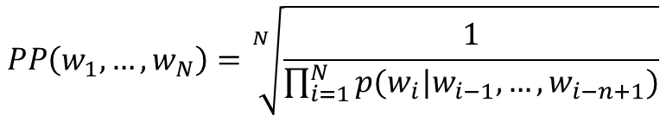
Perplexity
The inverse of the likelihood of the test set as assigned by the language model, normalized by the number of words
$$PP\left(w_{1},…,w_{N}\right)=\sqrt[N]{\frac{1}{\prod_{i=1}^{N}{p(w_{i}|w_{i−1},…,w_{i−n+1})}}}$$
N-gram language model

Slide 52
An experiment
Models
Unigram, Bigram, Trigram models (with proper smoothing)
Training data
38M words of WSJ text (vocabulary: 20K types)
Test data
1.5M words of WSJ text
Results
 | Unigram | Bigram | Trigram
Perplexity | 962 | 170 | 109

Slide 53
What you should know
N-gram language models
How to generate text documents from a language model
How to estimate a language model
General idea and different ways of smoothing
Language model evaluation

Slide 54
Further reading
Speech and Language Processing
Chapter 4: N-Grams

